Slide 1
MINI PROJECT ON BATTERY LEVEL INDICATOR
PERFORMED BY: Prabhakar tripathi(14bec090)
vyshali subramaniam(14bec103)
Guided by: prof. manisha upadhyay

Slide 2
Principle of working AND APPLICATIONS:
The heart of this battery level indicator circuit is LM3914 IC. This IC takes input analog voltage and drives 10 LED’s linearly according to the input analog voltage.
In this circuit there is no need of resistors in series with led’s because current is regulated by the IC.Battery level indicator indicates the status of the battery just by glowing LED’s. For example six LED’s are glowing means battery capacity 60% remains.
APPLICATIONS:
You can use this circuit to check car battery or inverter. So by using this circuit, we can increase the lifetime of battery. This circuit is designed based on lm3914 IC (Integrated chip). This IC is LED dot/bar display driver.The ;asr

Slide 3
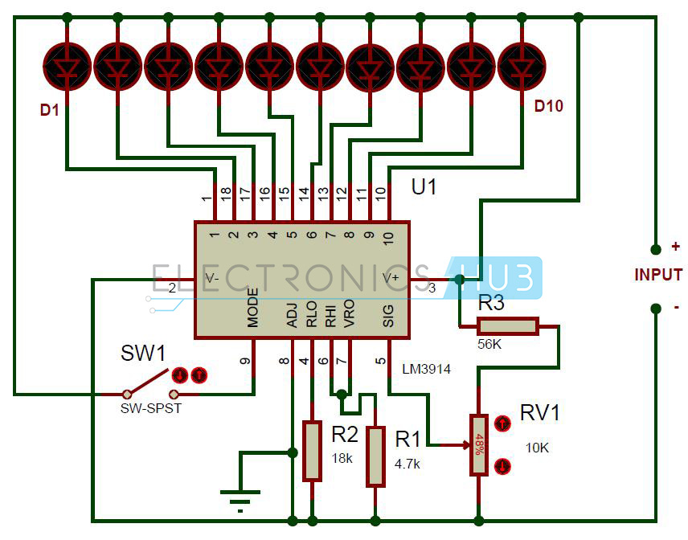
Battery Level Indicator Circuit Diagram:

Slide 4
Circuit Components:

